Slide 1
Biophysics
BT 301 Aug 2022

Slide 2
Fluorescence Spectroscopy

Slide 3
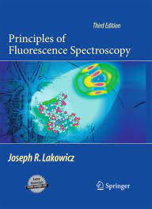
Book

Slide 4
Pulsed or time-domain fluorescence lifetime measurement

Slide 5
Phase-modulation or frequency-domain fluorescence lifetime measurement

Slide 6
Time-domain (left) and frequency-domain (right) fluorescence lifetime measurements of N-Acetyl-L-tryptophanamide

Slide 8
Time-correlated single photon counting (TCSPC) technique

Slide 9
Principle of TCSPC technique

Slide 10
Fluorescence Quenching

Slide 11
Quenchers
of Fluorescence

Slide 12
Stern-Volmer Plot (left) for Fluorescence Quenching

Slide 15
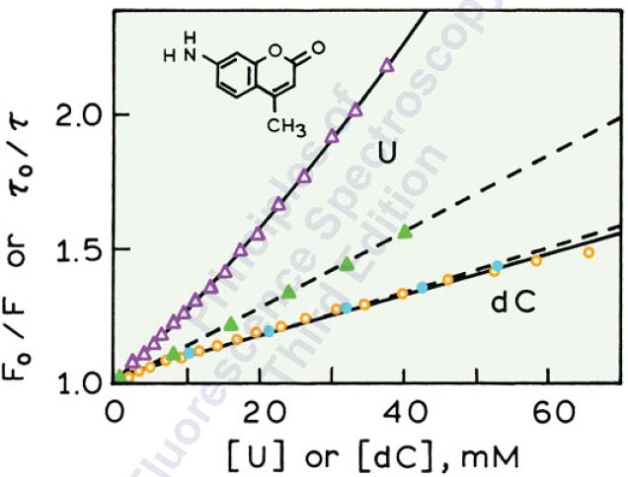
Static and Dynamin Fluorescence quenching of C120 by Uridine and deoxycytosine

Slide 16
Fluorescence Resonance Energy Transfer

Slide 17
Forster Resonance Energy Transfer in a protein with single Donor and single Acceptor

Slide 18
Forster Resonance Energy Transfer

Slide 19
Orientation factor kappa

Slide 20
Overlap Integral

Slide 21
Theory of Energy Transfer
Rate of Energy Transfer for donor(1) and acceptor(2) separated by distance R₂₁ is given by

Slide 22
Dependence of Energy Transfer efficiency on distance
R₀ is the Forster distance

Slide 23
Chemical structure of Melittin in the α-helical state.
The donor is tryptophan-19 and the
acceptor is a N-terminal dansyl group.
Overlap integral for energy transfer from a tryptophan
donor to a dansyl acceptor on melittin R₀ = 23.6 Angstroms

Slide 24
Emission spectra of the melittin donor (D) and
Acceptor-labeled melittin (D–A). Excitation at 282 nm.

